Slide 1



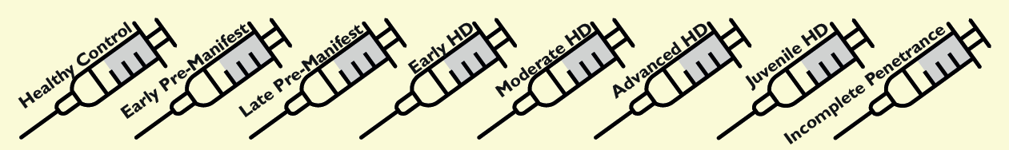
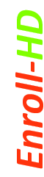

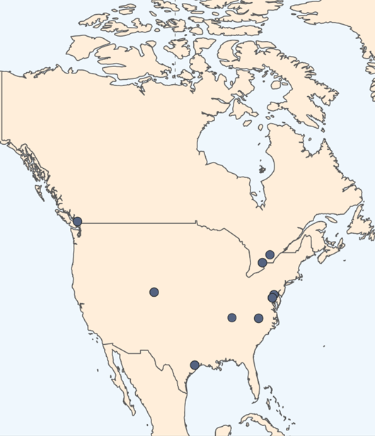
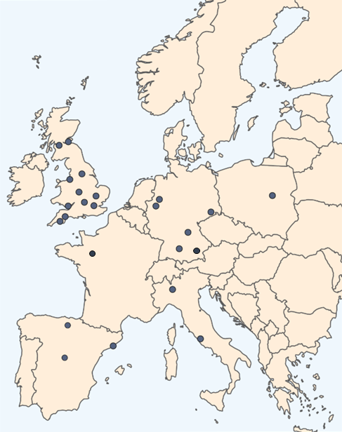
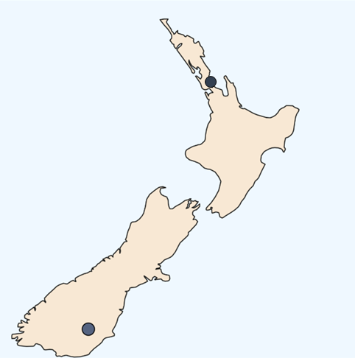
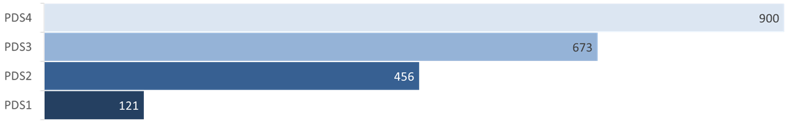
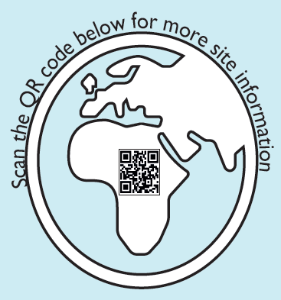
We would like to thank all the clinical sites and most importantly, the HD community, who’s dedication and perseverance is vital to the success of HD
Clarity.
What is The Aim of HDClarity?
TO ADVANCE HD RESEARCH
What Does HDClarity Participation Involve?
Participants attend annually and take part in two visits (Screening and Sampling) within a 30-day window. Some may attend an optional Repeat Sampling visit 4-8 weeks later:
In total, we hope to enroll 2500 individuals.
COLLECT: We are building a collection of high-quality cerebrospinal fluid (CSF), plasma and serum samples across 8 study groups for evaluation of biomarkers and molecular pathways relevant to Huntington’s Disease (HD) pathophysiology and therapeutic development.
0 – 90 days
Screening Visit
1). Confirm Eligbility
2). Obtain Consent
3). Neuro/Phys Exam
4). Safety Bloods
1 - 30 days
Sampling Visit
1). Neuro/Phys Exam
2). UHDRS Motor
3). CSF Collection
4). Blood Collection
4 - 8 weeks
RPT Sampling Visit
1). Neuro/Phys Exam
2). UHDRS Motor
3). CSF Collection
4). Blood Collection
CSF represents an optimal biofluid for the assessment of HD biomarkers due to its close anatomical and physiological proximity to the central nervous system. In addition, high quality plasma and serum samples are also collected matching the CSF collections.
HDClarity samples are processed, logged and deposited for long-term storage at BioRep s.r.l. For more information, please see HDClarity website at https://hdclarity.net/.
DISTRIBUTE: Samples can be requested by investigators around the world, allowing them to conduct groundbreaking research.
HDClarity samples can be used in several ways, including: - Biomarkers discovery and validation - Support of clinical trials - Understanding disease progression - Data integration with other studies - Method development
To request HDClarity samples for your research please see information at: https://enroll-hd.org/for-researchers/ access-data-biosamples.
There is 10-14 months between annual Screening Visits.
How Many HDClarity Visits Have Been Conducted So Far?
In total, we have completed 1861 Screening visit 1671 Sampling visits, and
208 Optional Repeat Sampling visits.
A multi-site cerebrospinal fluid collection initiative
to facilitate therapeutic development for Huntington’s disease
HDClarity Safety
Our data show that after 2069 spinal taps, the most common side effect is a mild or moderate headache. Only six severe adverse events were reported, corresponding to 0.29% of the total number of sampling visits.
Where Are HDClarity Sites Located?
New Zealand
.
HDClarity has continued to expand and is now active at 38 clinical sites, across 10 nations worldwide.
Feb 09, 2026
Fourth Dataset Release From HDClarity PDS4 Is Coming Late March 2026!
HDClarity PDS4 will include data from approximately 900 study participants, with study visit packages linked to one or more successfully collected CSF samples. As the largest longitudinal collection of high-quality CSF and blood ever assembled in HD, this carefully curated resource, accompanied by detailed phenotypic data, will enable a new generation of innovative scientific projects at a critical time for the development of novel therapeutics.
We are actively working to commence the study at more sites across Australasia, Europe, North and South America.
We are actively working to commence the study at more sites across Australasia, Europe, North and South America.
How are HDClarity Samples Being Used in Research?
Publicly available biomarker datasets derived from HDClarity samples
CSF biomarker assay results, N=220. Neurofilament light, haemoglobin, total protein, mutant huntingtin, total huntingtin
Somalogic proteomic data, N=579. Over 7,600 protein analytes in CSF and serum
Olink proteomic data, N=579. 2,925 proteins measured in CSF and serum
Mass Spec proteomic data, N=478. Unbiased LC/MS of CSF and plasma
Recent publications using HDClarity data:
Asgari AM et al. “24S-Hydroxycholesterol: A potential brain-derived biomarker of Huntington’s Disease.” medRxiv (preprint)
So far, we have distributed HDClarity samples for 40 projects and there are nine ongoing projects at various stages!
Use of HDClarity Samples in Posters at HDTC Palm Springs 2026
1. A harmonised NfL dataset across Enroll-HD, Track-HD, TrackOn-HD and HDClarity using the IVD grade Elecsys® NfL assay. Eve Tasiudi, Laura Zingaretti, Marcelo Boareto, Natallia Kalinava, Arun Karpur, Sabine Sellner, Luanna Dixson, Isabelle Schrurs, Nazia Maroof, Peter McColgan, Hilary Wilkinson, and David J. Hawellek
2. CSF and Plasma Extracellular Vesicle Proteins as Potential Biomarkers in Huntington’s Disease. Chrisovalantis Papadopoulos, Mari J. Aaltonen, Thomas Wild, Carleen Kluger, Denise Hartung, Hilary Wilkinson, Jim Rosinski, Thomas F. Vogt, and Ramee Lee
3. Exploratory analysis of PENK and PDYN as early markers of HD onset and progression. Julien Peladan, Kirsten Kuhlbrodt, Kinga Yang, Kristin Flechtner, Barbara Baldo, Jatin Vaidya, Jim Mills, Jeffrey Long, Monica Chu, Carmen Fernandez-Metzler, Todd Herbst, Arun Karpur, Hilary Wilkinson, Liliana Menalled, Balajee Somalinga, and Edith Monteagudo
Chief Investigator: Professor Edward Wild, MD PhD
CHDI Clinical Research Program Manager and Study Lead: Elena Pak
CHDI Vice President Fluid Biomarkers: Hilary Wilkinson, PhD
CHDI Chief Medical Officer: Cristina Sampaio, MD PhD
HDClarity is sponsored by University College London,
coordinated by UCL Huntington’s Disease Centre
and funded by CHDI Foundation, Inc.
Study Website: https://HDClarity.net
Clinical Study Homepage: https://clinicaltrials.gov
Bluesky: @hdclaritystudy.bsky.social

